Slide 1
RAMAN SPECTROSCOPY OF CARBON NANOTUBES
MADHAVA REDDY VARAKANTHAM
SIDHARTH SUKUMARAN NAIR
VAISHAKH GOPALAKRISHNAN NAIR

Slide 2
Contents
Introduction
  Carbon Nano Materials
  Carbon Nanotubes
Raman Spectroscopy
  Advantages and Disadvantages
Raman Features
  Raman Spectra of SWCNTs
Raman Spectra Analysis
  Chirality and Plots
  Chirality Indices
Applications and Summary
Future Research
References

Slide 3
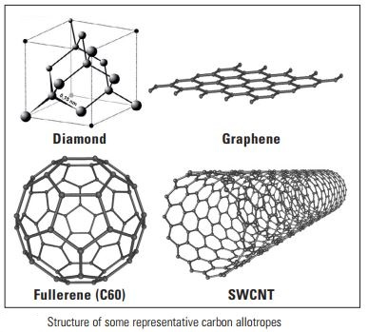
Carbon Nano Materials
Allotropes of Carbon
Pure Carbon Materials
Some of them are
  Diamond (Not nanomaterial)
  Graphene
  Fullerene
  Nano tubes

Slide 4
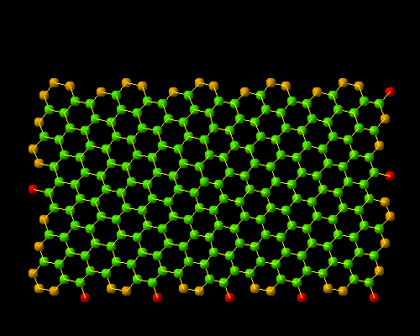
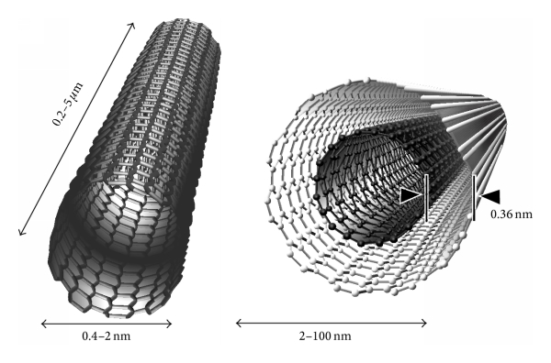
Carbon Nanotubes
Honeycomb arrangement of carbon atoms is Graphene
Carbon Nanotube made from rolled Graphene sheet
CNTs have high Specific strength
Have high tensile strength
https://spinoff.com/uploads/images/5a61bff027760
http://jnm.snmjournals.org/content/48/7/1039/F1.large

Slide 5
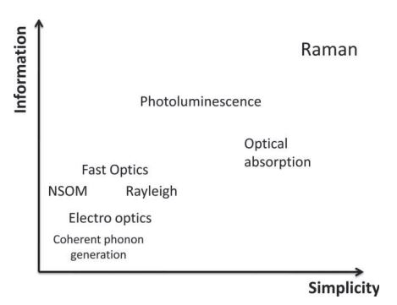
Raman Spectroscopy
Technique used to observe rotational, vibrational and other low frequency modes in a system.
Well suited method for the Morphology characterization of Carbon NanoTubes.
Highly sensitive to small changes in material structure
Can Distinguish Carbon Allotropes.
“Raman Spectroscopy of graphene and carbon nanotubes” et al. R Saito, M. Hofmann, G. Dresselhaus

Slide 6
Advantages
Disadvantages
Non-contact and Non-destructive analysis
Sub-Micron to nano scale spatial resolution with chemical compositions, structure of materials
Sample can be of any state like gas, liquid, solution, solid, crystal, emulsion (organic or Inorganic)
Sample preparation not needed and can be measured through glass window and in water.
Heating Through intense laser radiation can destroy samples.

Slide 7
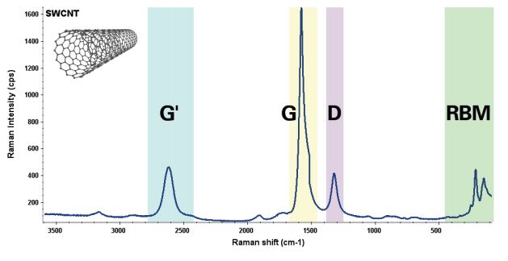
SWCNTs Raman Spectra
Raman spectrum of SWCNTs with prominent bands labeled
“Characterizing Carbon Materials with Raman Spectroscopy”,et al.Joe Hodkiewicz, Thermo Fisher Scientific, Madison, WI, USA

Slide 8
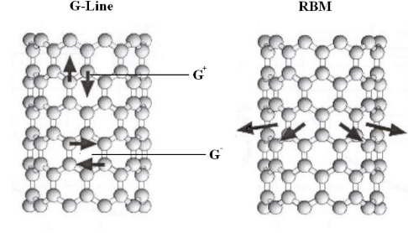
Features of Raman Spectra in SWCNTs
Radial breathing mode (RBM) (Low frequency range b/w 120 and 350 cm⁻¹)
G-band (High frequency range),
Other weak features: Induced D band (Hybridized vibrational mode, Defects of carbon atoms at open ends of nanotube) and iTOLA band (combination of optical and acoustic modes)

Slide 9
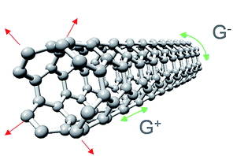
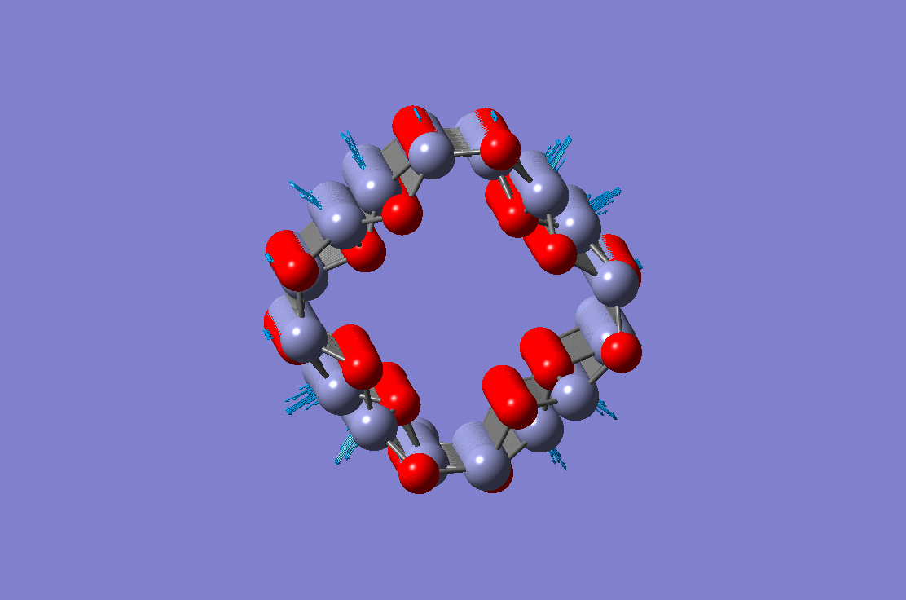
G-mode vibrations in SWCNTs
Radial breathing mode in SWCNTs
Notes:
http://pubs.rsc.org/en/content/articlehtml/2016/ra/c5ra28181d

Slide 10
Raman Spectra Analysis
Obtain diameter of SWCNT from RBM (ω_{RBM} is inversely proportional to the diameter of a SWCNT)
Length of SWCNT is calculated from the intensity of G band
Distinguish between metallic and semiconductor SWCNTs from G-band
Obtain chirality index of the SWCNT

Slide 11
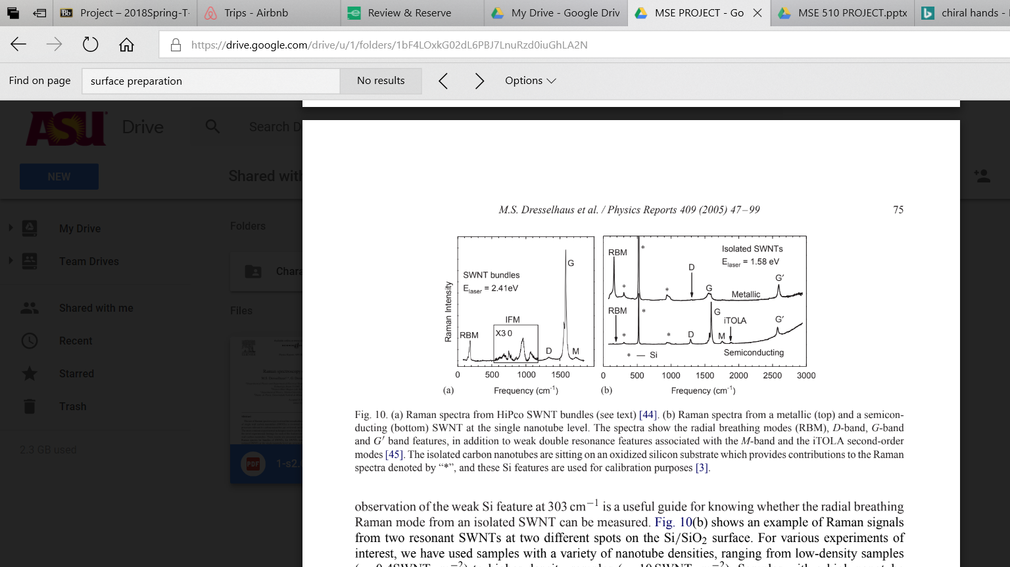
Raman intensity
M.S. Dresselhaus et al. / Physics Reports 409 (2005) 47–99

Slide 12
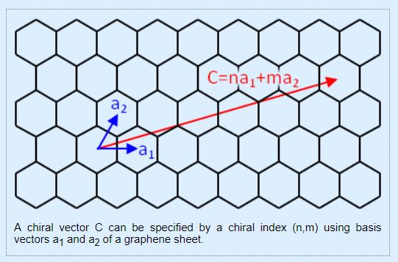
Chirality of SWCNTs
http://katogroup.riken.jp/en/nanotubechirality.html
Vector connecting two hexagon centers
Structure of SWCNTs are determined by Chirality
Interesting facts
  Depending on chirality electronic structure of SWCNTs becomes semiconducting or Metallic.
  Band Gap energy also depends on Chirality

Slide 13
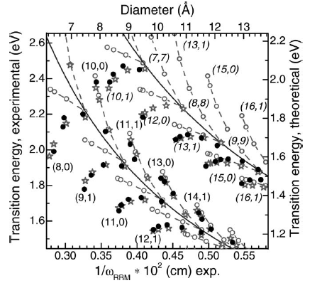
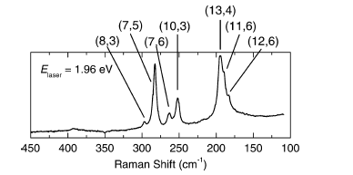
Kataura Plots
M. Cardona, R. Merlin (Eds.): Light Scattering in Solid IX, Topics Appl. Physics 108, 115–232 (2007)

Slide 14
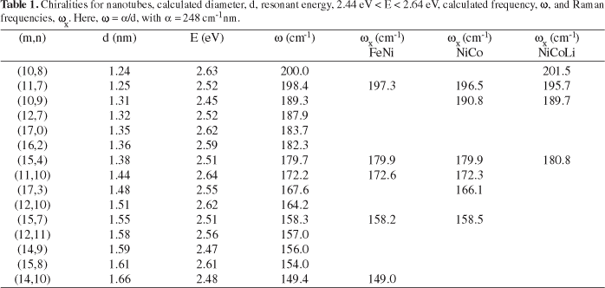
Chirality Indices values
http://www.scielo.br/img/fbpe/mr/v6n1/1a03t1.gif

Slide 15
Applications of CNTs
Composite materials
Textiles,Alloys,Coatings and Films
Electronics
Transistors, Solar cells, Cables, wires
Energy Storage
Lithium Batteries, Supercapacitors
Bio Medical
Biodegradable nano components for tissue repair, health monitoring.
Environmental
Water Treatment, Nanotube based sensors for pollutant detection

Slide 16
Summary
Instruments are fast and provide flexibility in samples
Energy of laser excitation is also very important due to the results obtained, as shown in the Kataura plot.
Using Raman spectra, we can obtain structural morphology of SWCNT (chirality index, diameter and so on)
CNTs have huge potential for the future and thus their characterization is crucial

Slide 17
Future Research Opportunities
Scope for controlling the chirality(ie, metallic and semiconducting nature) which has an impact on the structure on CNTs.
Can use Raman Spectroscopy as a tool for exploring electronic structure of filled tubes.
There is also scope for CNTs in the I/R optics industry since they have been shown to absorb Infrared light.
There are some research in progress about bonding a single strand of DNA to the nanotube and then inserting it into a cell.
Research is in progress to develop highly sensitive sensor technology and in Energy storage

Slide 18
References
[1] Thomsen, Christian. “Raman Scattering in Carbon Nanotubes.” Nanotubes and Nanowires, 2003, doi:10.1117/12.507435.
[2] Mic[5] “7 Raman Spectra of Graphene and Single-Walled Carbon Nanotubes (SWCNTs).” An Introduction to Graphene and Carbon Nanotubes, 2016, pp. 99–126., doi:10.1201/9781315368191-8.
[3]hel, T, et al. “About the Indexing of the Structure of Single-Walled Carbon Nanotubes from Resonant Raman Scattering.” Advances in Natural Sciences: Nanoscience and Nanotechnology, vol. 1, no. 4, Dec. 2011, p. 045007., doi:10.1088/2043-6262/1/4/045007.
[4] Dresselhaus, M.s., et al. “Raman Spectroscopy of Carbon Nanotubes.” Physics Reports, vol. 409, no. 2, 2005, pp. 47–99., doi:10.1016/j.physrep.2004.10.006.
[5] Wang, Yan, et al. “Raman Spectroscopy of Carbon Materials: Structural Basis of Observed Spectra.” Chemistry of Materials, vol. 2, no. 5, 1990, pp. 557–563., doi:10.1021/cm00011a018
[6] Wepasnick, Kevin A., et al. “Chemical and Structural Characterization of Carbon Nanotube Surfaces.” Analytical and Bioanalytical Chemistry, vol. 396, no. 3, 2010, pp. 1003–1014., doi:10.1007/s00216-009-3332-5.
[7] Pool, Albert J., et al. “Structural Characterization of Carbon Nanotubes via the Vibrational Density of States.” Carbon, vol. 118, 2017, pp. 58–65., doi:10.1016/j.carbon.2017.03.030.
[8] Wepasnick, Kevin A., et al. “Chemical and Structural Characterization of Carbon Nanotube Surfaces.” Analytical and Bioanalytical Chemistry, vol. 396, no. 3, June 2010, pp. 1003–1014., doi:10.1007/s00216-009-3332-5.
[9] Medjo, Rolant Eba. Characterization of Carbon Nanotubes. INTECH Open Access Publisher, 2013.

Slide 19
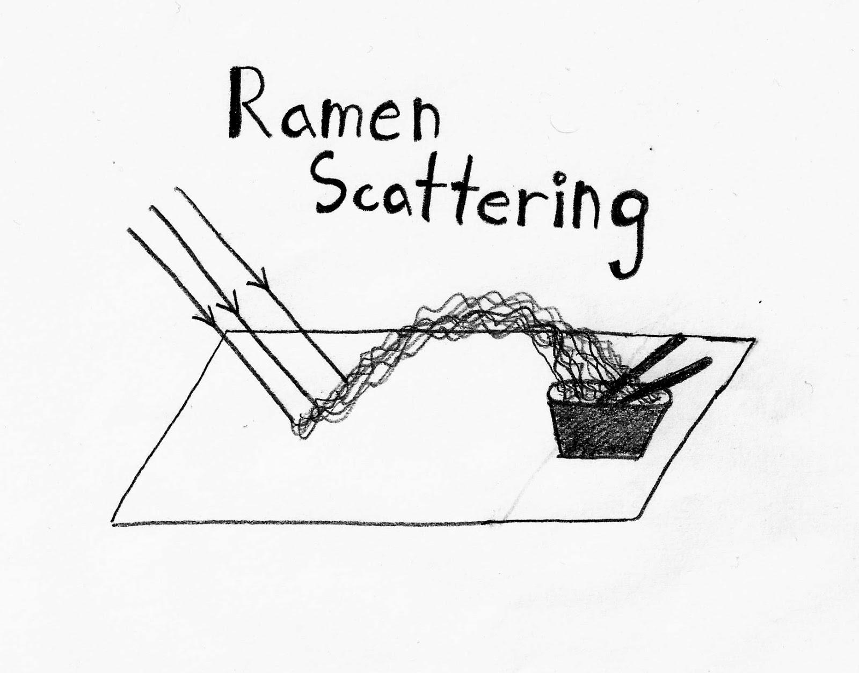
THANK YOU

